Slide 1
XAML for Windows 10: Layout Fundamentals
Daren May | President, CRANK211
Jerry Nixon| Developer Evangelist, Microsoft

Slide 2
Course Modules
XAML for Windows 10: Controls
01 | Control Fundamentals
02 | Custom controls
03 | Styling and resources

Slide 3
01 | Layout Fundamentals

Slide 4
Module Overview
Build a custom control

Slide 5
Custom controls

Slide 6
Building a control
Notes:
Create a template (CheckBox + Button)
Notice the DefaultStyleKey + Generic.xaml
Add CheckBox.CheckText + Button.ButtonText properties
Add CheckBox.IsChecked + Button.Command properties
Data bind Button.IsEnabled to CheckBox.IsChecked
Give the CheckBox & Button an x:Name
Create Custom GetTemplatedChild<T>
Create Custom Clicked, Checked

Slide 7
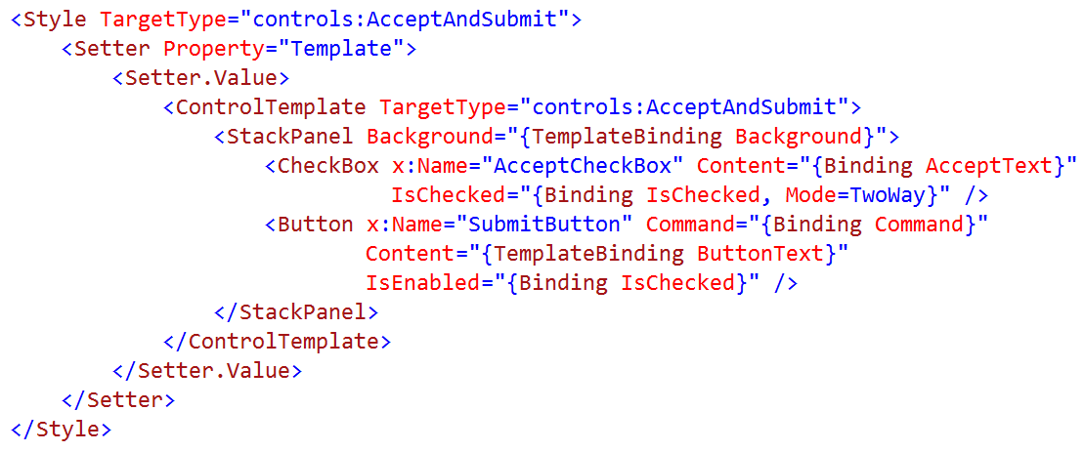
Adding custom templates

Slide 8
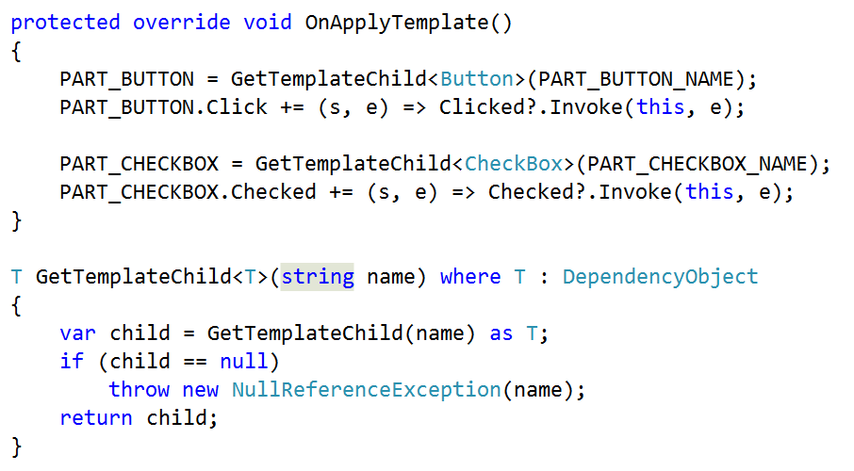
Customize GetTemplateChild()

Slide 9
Adding custom behavior

Slide 10
Adding custom properties

Slide 11
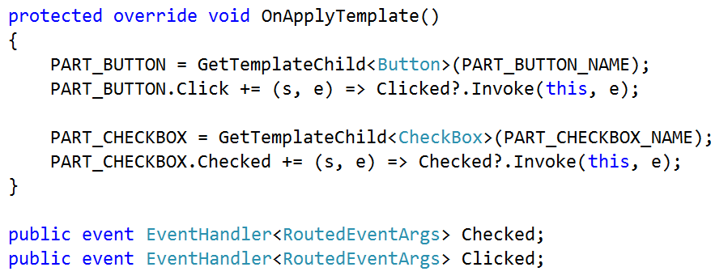
Adding custom events

Slide 12
Implement AcceptAndSubmit
Reusable
Encapsulated
Template-ready
Data bindable
Programmable
Simple

Slide 13
Summary
Build a custom control

